Slide 1
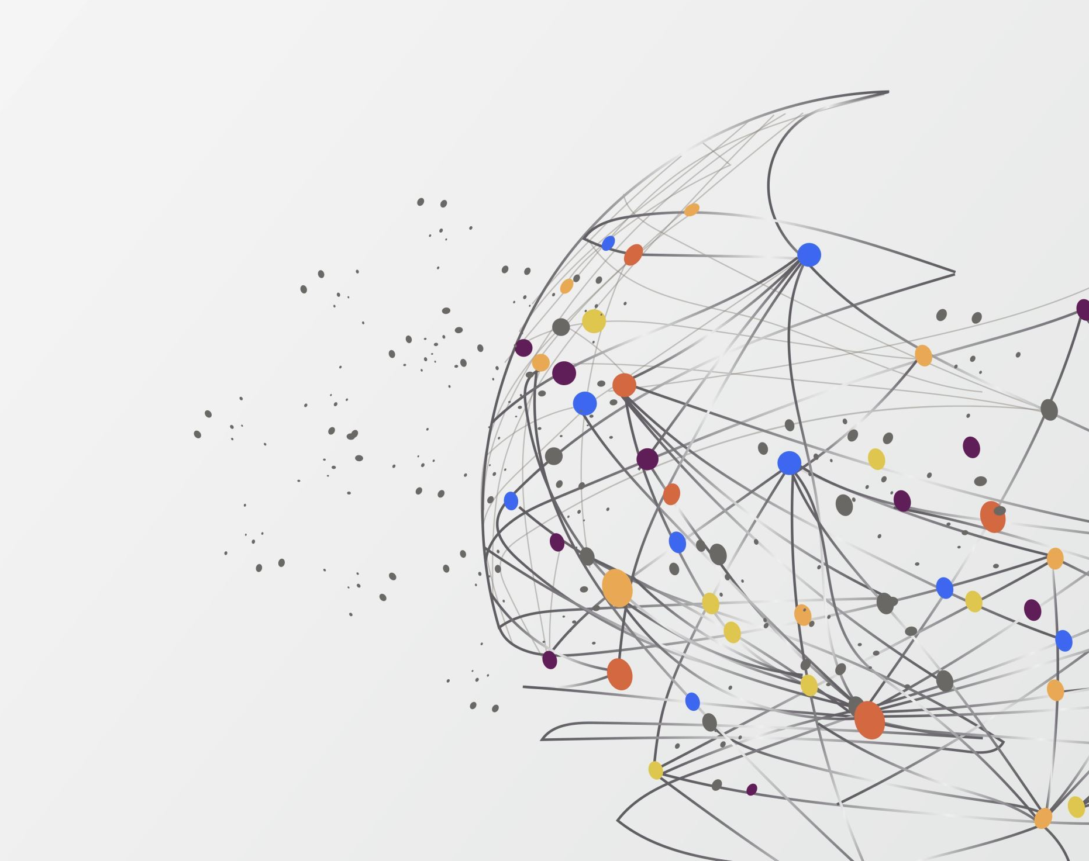
Research Project – Machine Learning using Python
Course Title : Advanced Topics - Web Dev
Mahfuzur Rahman and Pablo Quintana

Slide 2
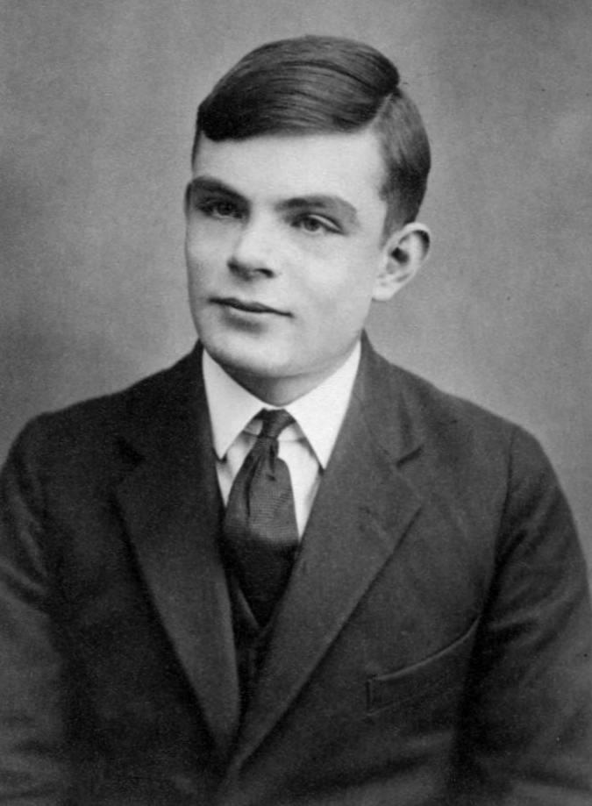
Alan Turing
AI – A little history
“On Computable Numbers” (1936)
Describing What Came to be Called the "Turing Machine"

Slide 3
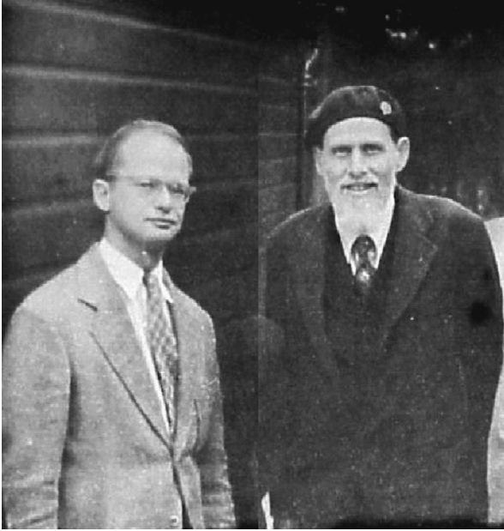
Warren McCullough and Walter Pitts
AI – A little history
“A Logical Calculus of the ideas Imminent in
Nervous Activity” (1943)
The first mathematical model of a neural network

Slide 4
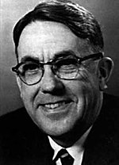
Arthur Samuel
AI – A little history
He popularized the term "machine learning" in 1959
The Samuel Checkers-playing Program was among the
world's first successful self-learning programs

Slide 5
AI Winter and Big Data
AI – A little history
From 1974 to 1980, AI funding declined drastically, making this time known as the First AI Winter.
Interest in AI wouldn't be revived until years later with the advent of expert systems.
This would eventually end with another AI winter from the late 1980s to mid-90s.
After that, advances in computing power and Big data allowed researchers to develop more sophisticated learning algorithms, powering AI until today.

Slide 6
What is Machine Learning?
Is a branch of artificial intelligence.
Gives computers the ability to learn without explicitly being programmed.
Machine learning starts with data — numbers, photos, or text, like bank transactions, pictures of people or even bakery items, repair records, time series data from sensors, or sales reports.
Use supervised, unsupervised, and Reinforcement learning.
Supervised learning uses labeled training data, and unsupervised learning does not. Reinforcement trains machines through trial and error to take the best action by establishing a reward system.
Can be descriptive, meaning that the system uses the data to explain what happened; predictive, meaning the system uses the data to predict what will happen; or prescriptive, meaning the system will use the data to make suggestions about what action to take.
Definitions

Slide 7
What is Neural Networks?
Neural networks are a subfield of machine learning.
The idea behind neural networks was first born in the 1950s with the perceptron algorithm.
A perceptron is a simplified model of a human neuron that accepts an input and performs a computation on that input.
The output is then fed to an activation function, which decides whether the neuron will “fire” based on the output value.
While one perceptron cannot recognize complicated patterns on its own, there are thousands, millions, or even billions of connections between the neurons in a neural network. This allows the network to handle even highly complex inputs.
Researchers “train” a neural network over time by analyzing its outputs on different problems and comparing them with the correct answers.
Using an algorithm known as backpropagation, the neural network can adjust the influence of any particular node in the network, attempting to reduce the errors that the network makes when calculating a final result.
Definitions

Slide 8
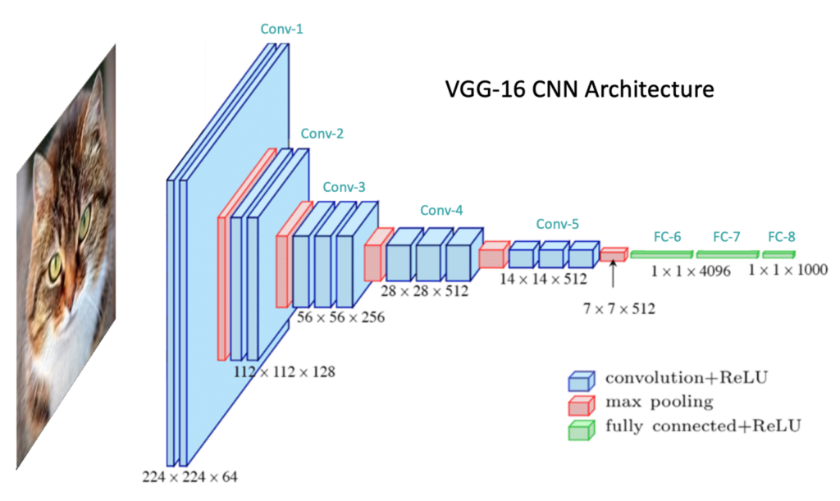
Types of Neural Networks?
Convolutional Neural Networks (CNNs)
Frequently used for the tasks of image classification.
For example, suppose that you have a set of photographs and you want to determine whether a cat is present in each image.
Neurons that are located earlier in the network are responsible for examining small windows of pixels and detecting simple, small features such as edges and corners. These outputs are then fed into neurons in the intermediate layers, which look for larger features such as whiskers, noses, and ears. These outputs are then used to make a final judgment about whether the image contains a cat.
Definitions

Slide 9
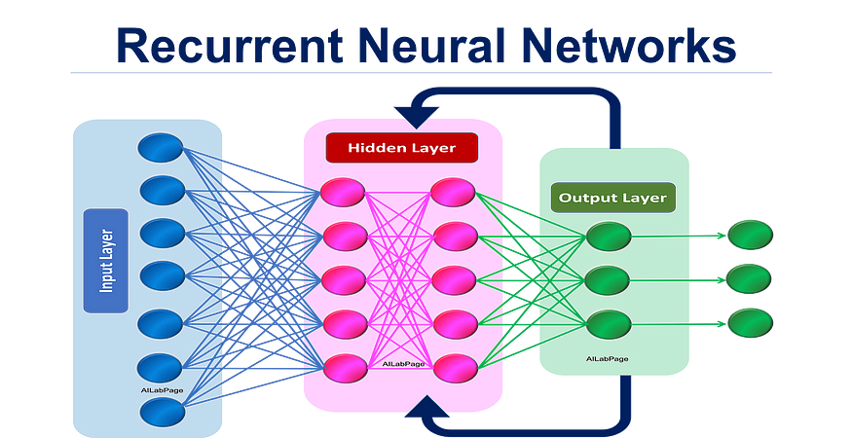
Types of Neural Networks?
Recurrent Neural Networks (RNNs)
strong choice for building up sequential representations of data over time: tasks such as document translation and voice recognition and Natural Language Processing (NLP).
RNNs are capable of “remembering” the network’s past outputs and using these results as inputs to later computations.
By including loops as part of the network model, information from previous steps can persist over time, helping the network make smarter decisions.
Definitions

Slide 10
ML Algorithms
Supervised Learning
Linear Regression | Stock Price Prediction, Predicting housing prices, Predicting customer lifetime value.
Logistic Regression | Predicting credit risk score, Customer churn prediction.
Decision Tree | Customer churn prediction, Credit score modeling, Disease prediction.
Random Forests | Credit score modeling, Predicting housing prices.
Support Vector Machines (SVMs) | Intrusion detection, email classification, bioinformatics, finance for predicting stock prices
Deep Learning CNN and RNN | Computer Vision, Natural Language Processing.
Applications
Unsupervised Learning
K-Means | Customer segmentation, Recommendation systems.
Hierarchical Clustering | Fraud detection, Document clustering based on similarity.
Gaussian Mixture Models | Customer segmentation, Recommendation systems.
Apriori Algorithm | Product placements, Recommendation engines, Promotion optimization.

Slide 11







Deep Learning and Computer Vision
Computer Vision Applications
Face Recognition | Object Detector
Object Classification | Object Tracking
Medical imaging processing | Autonomous vehicles
Augmented reality | Manufacturing
Python and library tools

Slide 12
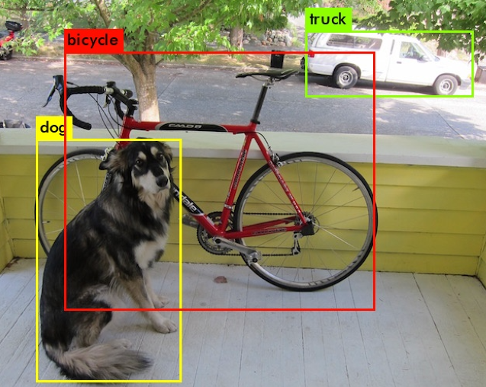
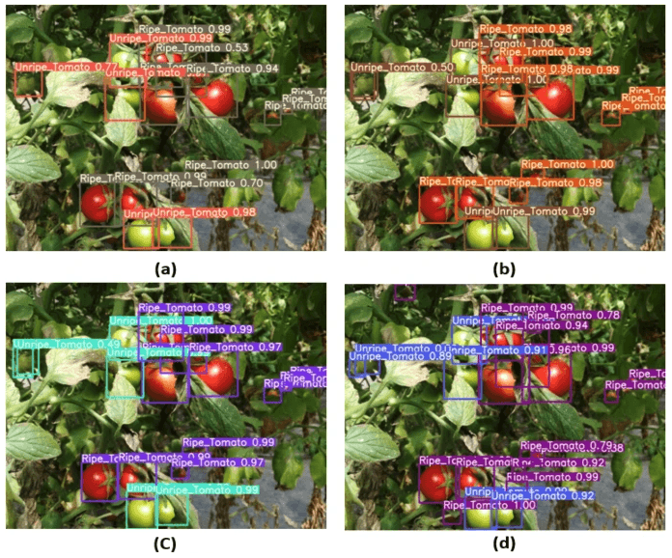
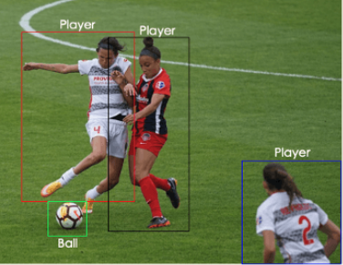
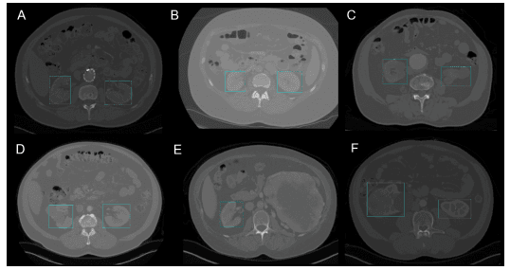

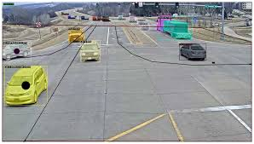
Computer Vision
Examples

Slide 13
References
https://www.ibm.com/topics/machine-learning
https://www.techtarget.com/searchenterpriseai/definition/machine-learning-ML
https://www.simplilearn.com/tutorials/deep-learning-tutorial/what-is-deep-learning

